Slide 1


Unveiling Insights: Exploratory Data Analysis in BCG Assignment

Slide 2

Introduction
:EDA in BCG Assignment

Slide 3

What is Exploratory Data Analysis?
Exploratory Data Analysis (EDA) is a technique used to analyze and summarize data sets. It helps to uncover patterns, identify outliers, and gain initial insights into the data. Through visualizations and statistical summaries, EDA provides a foundation for further analysis and decision-making.

Slide 4

Benefits of EDA
By conducting EDA, we can gain a deeper understanding of the data, identify data quality issues and missing values, detect outliers, and explore potential relationships between variables. EDA also helps in selecting appropriate modeling techniques and preparing data for further analysis.

Slide 5

Common EDA Techniques
Some common EDA techniques include data visualization using histograms, scatter plots, and box plots, summary statistics such as mean, median, and standard deviation, correlation analysis, and data cleansing techniques like handling missing values
and outliers.

Slide 6

Case Study: BCG Assignment
In this case study, we will apply EDA techniques to analyze a dataset provided by BCG. We will explore the data, identify key insights, and present our ﬁndings to help BCG make informed business decisions. Our analysis will focus on uncovering trends, patterns, and potential opportunities within the
dataset.

Slide 7
Dataset info:
The provided datasets provide information about SME customers' characteristics, historical consumption, contract details, pricing, and churn status. The client_data.csv dataset captures various customer-related features, while the price_data.csv dataset contains historical pricing information.
Analyzing these datasets together can help understand the factors influencing customer churn and explore the relationship between pricing and churn behavior.

Slide 8
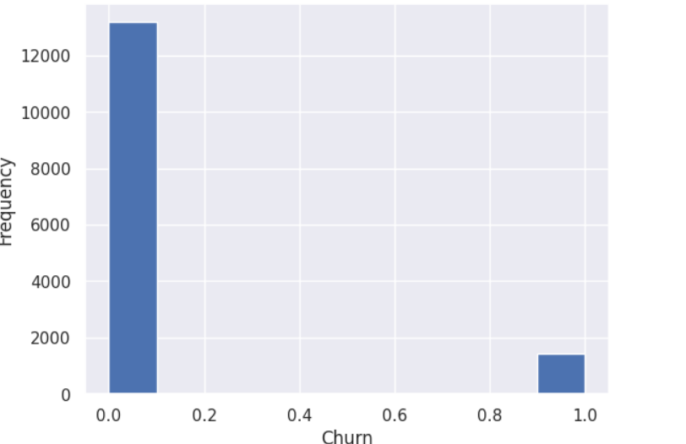
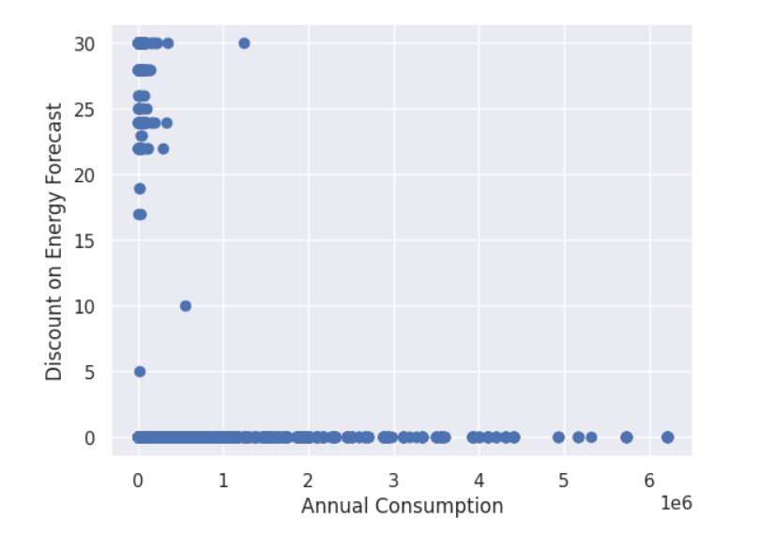
Screenshots:

Slide 9
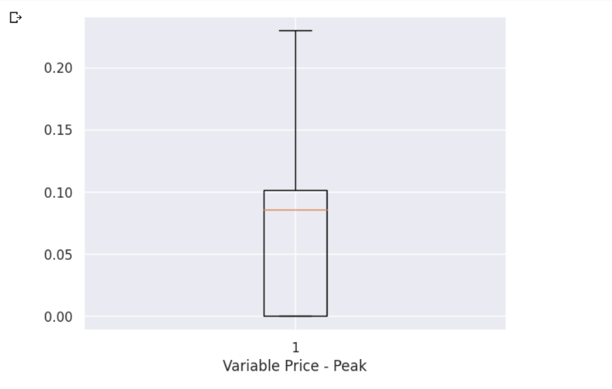
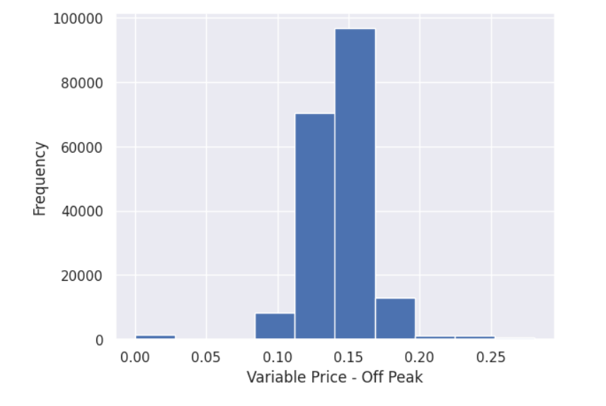

Slide 10
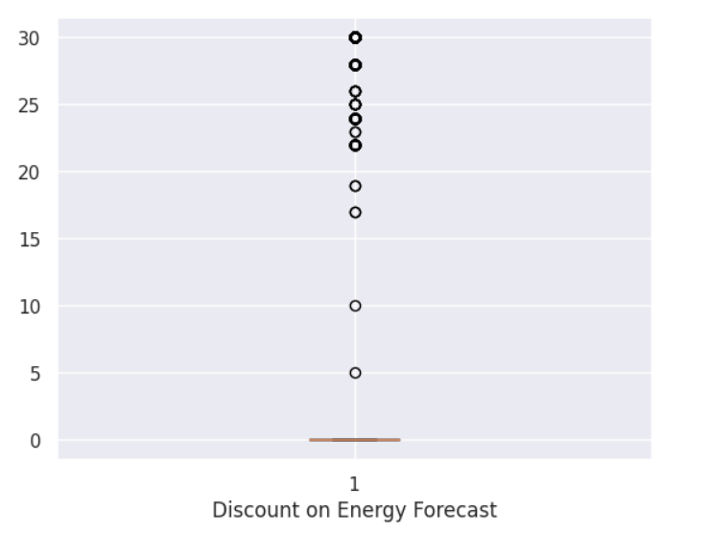
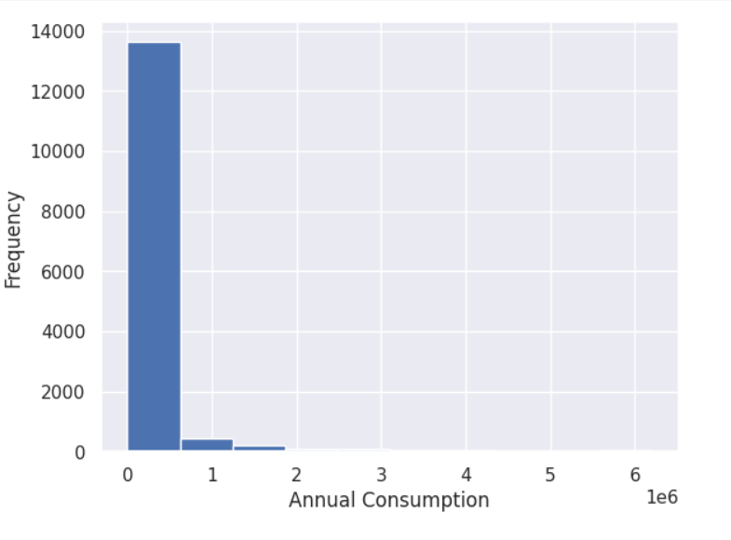

Slide 11
Conclusion
Exploratory Data Analysis is a crucial step in understanding and interpreting data. By applying EDA techniques, we can uncover valuable insights, detect anomalies, and make data-driven decisions. It provides a solid foundation for further analysis and modeling. Remember, EDA is a continuous process that should be iteratively performed throughout any data analysis project.

Slide 12
Thanks
Do you have any questions?
Jai Chaudhrani jai.chaudhrani2000@gmail.com

